Slide 1


Deininger and Squire 1996

Slide 2
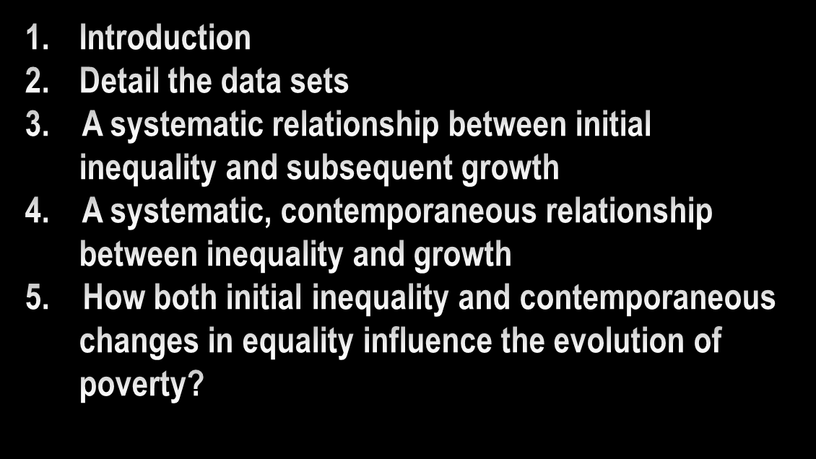
construction

Slide 3


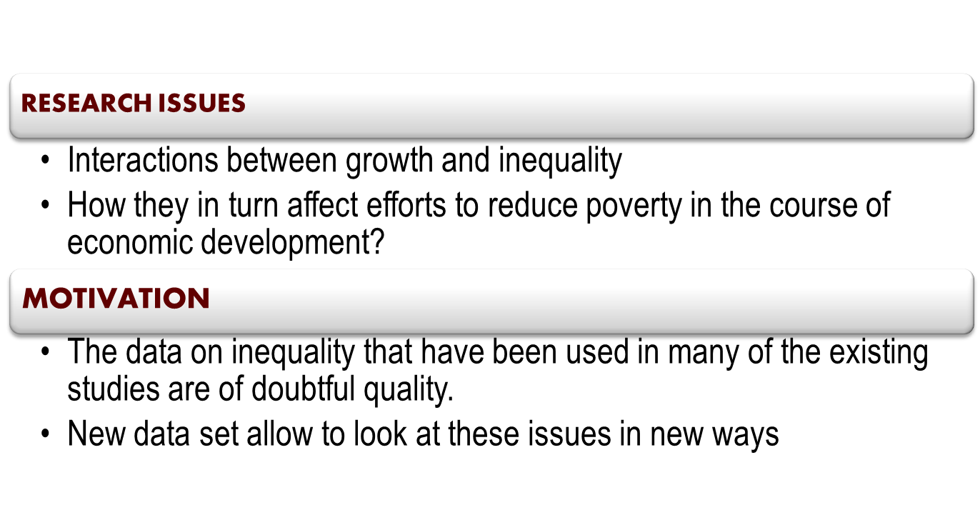
1.INTRODUCTION

Slide 4
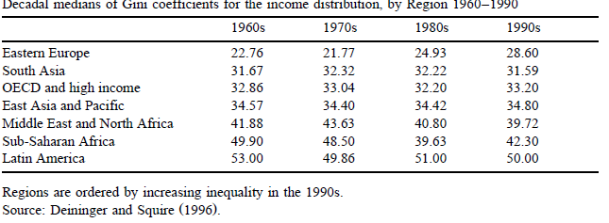
2.The data
- a data set on income inequality that contains at least one observations on Gini index for 108 countries and information on shares received by different quintiles in the population for 103 countries.

Slide 5
2.2. Land distribution
- data on the initial distribution of operational holdings of agricultural land from the decennial FAO World Census of Agriculture and other sources for 261 observations from 103 countries
The distribution of land is more concentrated and characterized by greater cross-country variation than that of income
Attractions of Data on land holdings
possession of land could be a major determinant of individuals’ productive capacity and their ability to invest
The distribution of land is relatively easily ascertained and does not require assumptions regarding the mapping from income flows into stocks of assets.
Coverage is more equal both geographically and over time than for data on income distribution

Slide 6
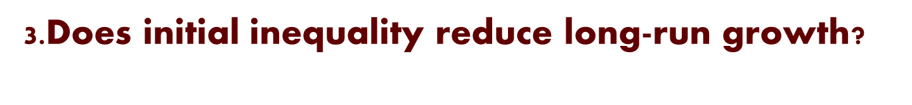
Investigate whether the strong relationship between initial inequality and long-term growth holds up to the scrutiny of better data
MAIN RESULTS
The effect of the initial income distribution on subsequent growth is not very robust
inequality in the initial distribution of land is significantly associated with lower subsequent growth
The fact that a significant relationship between inequality and growth does not exist in democratic societies suggests that explanations other than democratic voting may be at work

Slide 7
3.1.Theorical basis for an inequality-growth relationship
1. A negative relationship between inequality and growth could emerge if investments in human or physical capital are lumpy and have to be financed through credit.
Information is costly and imperfect
Equilibrium credit rationing
-agent will be able to obtain credit only if they own assets that can be used as collateral
-more unequal distribution of assets->a greater number of people are credit constrained
Lower aggregate growth

Slide 8
2. Inequality could possibly affect future growth through political channels.
Degree of inequality
The median voter’s desired pattern of policies
Individual’s ability to access political markets and participate in costly lobbying
Median voter theorem
the median voter’s distance from the average capital endowment in the economy increases with the aggregate inequality of wealth
->the median voter will be led to approve a higher tax rate
->reduce incentive for investment
->lower growth

Slide 9
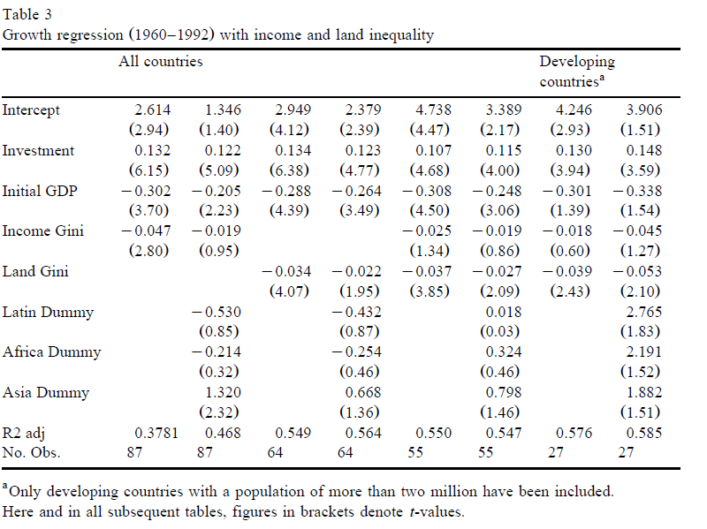

Slide 10
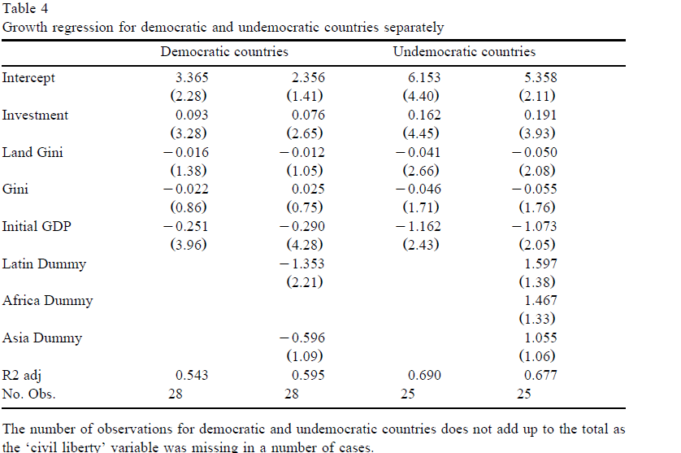

Slide 11
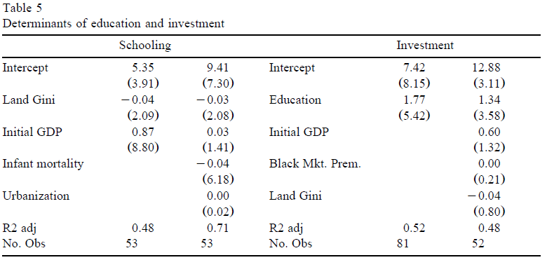
2.Credit market imperfections and inequality
- credit market imperfections would be consistent with inequality being more important in low-income countries than high-income ones.
There is tentative support for a credit-market mediated link between the initial distribution of assets and subsequent growth.
3. Initial inequality appears to affect aggregate growth through schooling.
Negative effect of initial inequality on schooling
Overall level of schooling attainment in the population are the single most powerful explanatory variable for investment.
Initial inequality->lower schooling->lower investment->lower aggregate growth
Significant!
Notes:
We find that initial inequality affects future growth in undemocratic countries, buth not in democratic ones, providing little support for democratic voting as the root of the inequzlity-growth link.

Slide 13


Conclusion
There is no support for a redistributive median-voter-based explanation of initial inequality’s effect on growth; on the contrary, there is stronger support for an explanation based on imperfections in financial markets for credit and insurance
Initial inequality in the distribution of land (but less so of income) appears to be associated with lower subsequent growth
Such imperfections appears to be more relevant for investment in human capital rather than physical capital
Notes:
We analyze the effect of initial inequality on subsequent growth for growth episodes where the available distributional data span at least 10 years.

Slide 14
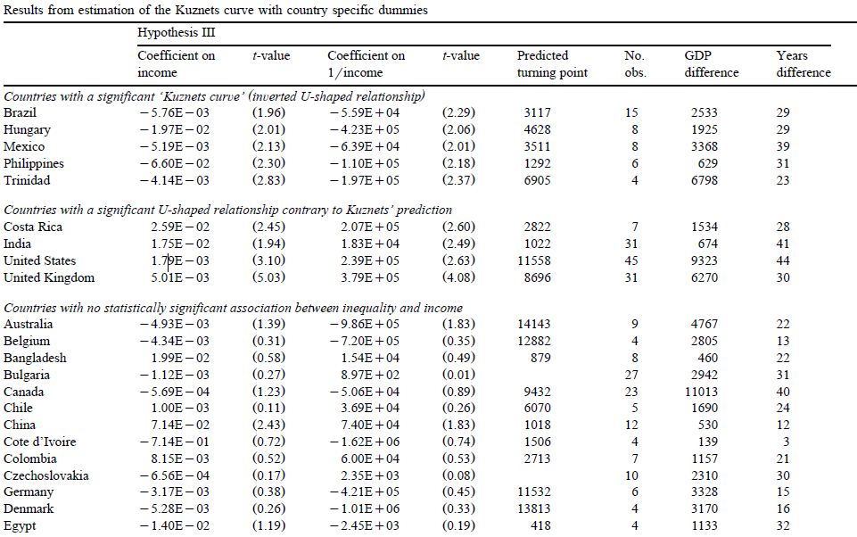
2.Testing individual countries
Notes:
We analyze the effect of initial inequality on subsequent growth for growth episodes where the available distributional data span at least 10 years.

Slide 15
RESULTS
- 40/49 countries :no statistically significant U-or inverted U-shaped relationship between the level of income and inequality, at the 5% level of significance.
- 5/49 countries: support the presence of an ‘inverted U’
Focusing only on the 16 countries with 10 or more observations
- Relationship is confirmed only one of them.
- No relationship in 12 cases
In 3 cases, the data support a relationship contrary to the one predicted by Kuznets
“Based on the available evidence, the Kuznets hypothesis is either too flat to be noticeable in the data or is not relevant for developing countries.”
Notes:
We analyze the effect of initial inequality on subsequent growth for growth episodes where the available distributional data span at least 10 years.

Slide 16
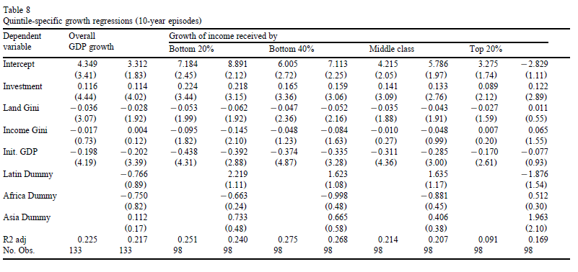

Slide 17
Conclusions
1.Initial land inequality is important for the poor, but not for the rich whose income growth is not significantly affected by this variable.
2.Investment is significant for all individual quintile groups.
3.Unable to ascertain a robust and consistent effect of either schooling or other variables on income growth for specific quintiles in the population.

